Slide 1
Virtual Object Controller of a Robot Manipulator
Brian Wilcox
2.152 Term Project

Slide 2
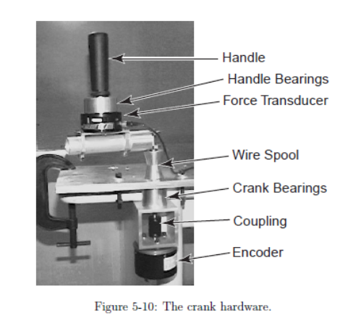
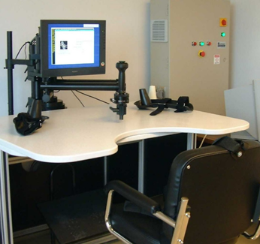
Motivation: Study Human Motor Control - Crank

Slide 3
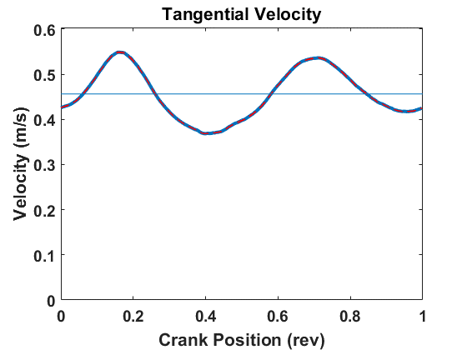
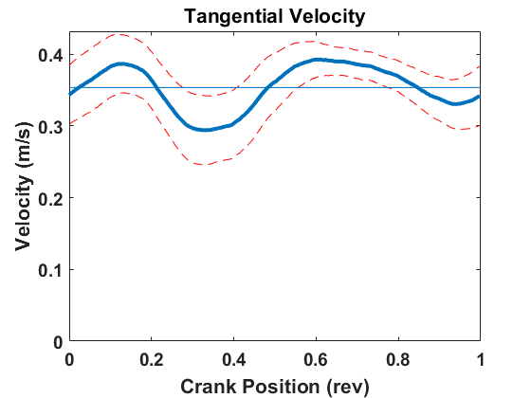
Effects of inertia and nonlinearities
Robot commanded to follow circle
Subject rotating robot handle “crank” at medium speed

Slide 4
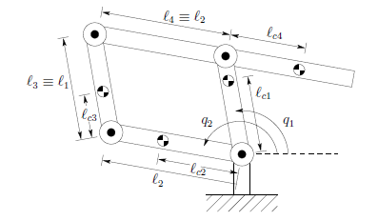
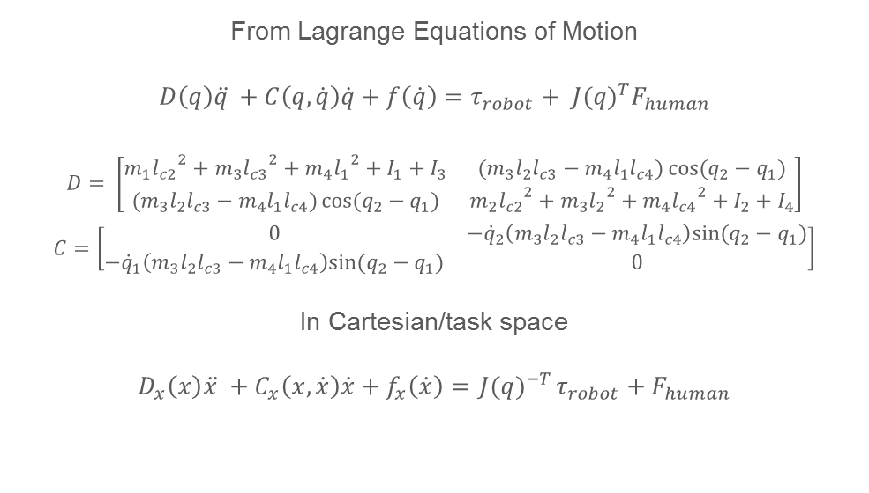
System Model: 5-Linkage (Parallel) Planar Arm
From Lagrange Equations of Motion
$$D\left(q\right)\ddot{q }+C\left(q,\dot{q}\right)\dot{q}+f\left(\dot{q}\right)=τ_{robot}+{{ J(q)}^{T}F}_{human}$$
$$D= \left[\begin{matrix}m_{1}{l_{c2}}^{2}+m_{3}{l_{c3}}^{2}+m_{4}{l_{1}}^{2}+I_{1}+I_{3} & (m_{3}l_{2}l_{c3}−m_{4}l_{1}l_{c4})\cos{(q_{2}−q_{1})} \\ (m_{3}l_{2}l_{c3}−m_{4}l_{1}l_{c4})\cos{(q_{2}−q_{1})} & m_{2}{l_{c2}}^{2}+m_{3}{l_{2}}^{2}+m_{4}{l_{c4}}^{2}+I_{2}+I_{4}\end{matrix}\right]$$
$$C=\left[\begin{matrix}0 & −{\dot{q}}_{2}\left({m_{3}l}_{2}l_{c3}−m_{4}l_{1}l_{c4}\right)sin⁡(q_{2}−q_{1}) \\ −{\dot{q}}_{1}\left({m_{3}l}_{2}l_{c3}−m_{4}l_{1}l_{c4}\right)sin⁡(q_{2}−q_{1}) & 0\end{matrix}\right]$$
In Cartesian/task space
$$D_{x}\left(x\right)\ddot{x }+C_{x}\left(x,\dot{x}\right)\dot{x}+f_{x}\left(\dot{x}\right)={ J(q)}^{−T}τ_{robot}+F_{human}$$

Slide 5
Controller Design Goals
Cancel inertial and nonlinear effects
Simulate virtual crank constraint and inertia
Compensate for inaccuracy of model

Slide 6
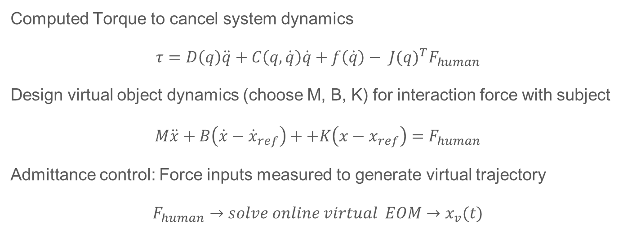
Virtual Object Admittance Control
Computed Torque to cancel system dynamics
$$τ=D\left(q\right)\ddot{q}+C\left(q,\dot{q}\right)\dot{q}+f\left(\dot{q}\right)−{{ J(q)}^{T}F}_{human}$$
Design virtual object dynamics (choose M, B, K) for interaction force with subject
$$M\ddot{x}+B\left(\dot{x}−{\dot{x}}_{ref}\right)++K\left(x−x_{ref}\right)=F_{human}$$
Admittance control: Force inputs measured to generate virtual trajectory
$$F_{human}→solve online virtual EOM→x_{v}(t)$$

Slide 7

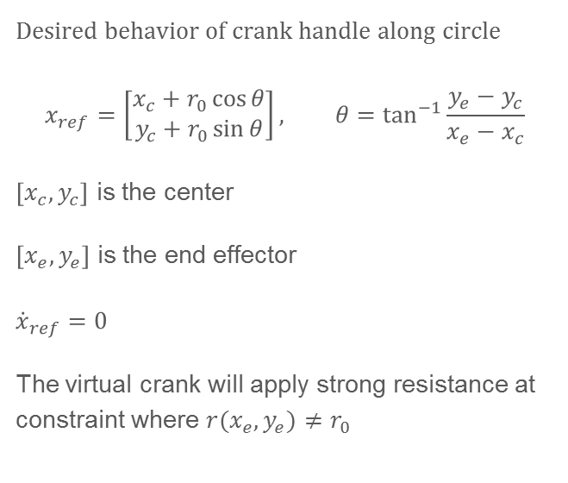
Virtual Object Constraint
K,B,
Desired behavior of crank handle along circle
$$x_{ref}=\left[\begin{matrix}x_{c}+r_{0}\cos{θ} \\ y_{c}+r_{0}\sin{θ}\end{matrix}\right], θ=\tan^{−1}{\frac{y_{e}−y_{c}}{x_{e}−x_{c}}}$$
$\left[x_{c}, y_{c}\right]$ is the center
$\left[x_{e}, y_{e}\right]$ is the end effector
$${\dot{x}}_{ref}=0$$
The virtual crank will apply strong resistance at constraint where $r(x_{e}, y_{e})≠r_{0}$
$$r_{0}$$

Slide 8

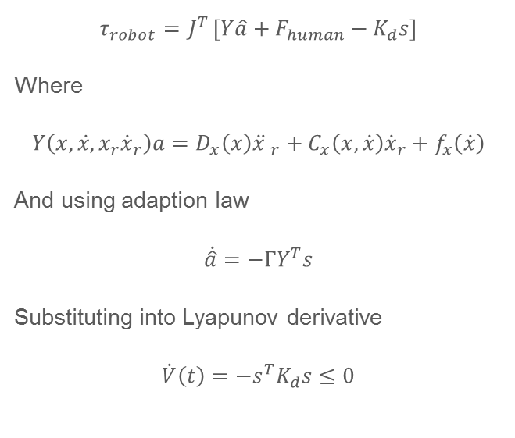
Adaptive Control
Lyapunov function candidate
$$V\left(t\right)=\frac{1}{2}\left(s^{T}D_{x}s+{\tilde{a}}^{T}Γ^{−1}\tilde{a}\right)$$
With error term
$$s=\dot{x}−{\dot{x}}_{r}=\dot{\tilde{x}}+Λ\tilde{x}$$
Lyapunov derivative
$$\dot{V}\left(t\right)=s^{T}\left({ J}^{−T}τ_{robot}−D_{x}{\ddot{x }}_{r}−C_{x}{\dot{x}}_{r}−f_{x}−F_{human}\right)+\dot{\hat{a}}Γ^{−1}\tilde{a}$$
$$τ_{robot}={ J}^{T}\left[Y\hat{a}+F_{human}−K_{d}s\right]$$
Where
$$Y\left(x,\dot{x,}x_{r}{\dot{x}}_{r}\right)a=D_{x}\left(x\right){\ddot{x }}_{r}+C_{x}\left(x,\dot{x}\right){\dot{x}}_{r}+f_{x}\left(\dot{x}\right)$$
And using adaption law
$$\dot{\hat{a}}=−ΓY^{T}s$$
Substituting into Lyapunov derivative
$$\dot{V}\left(t\right)=−{s^{T}K}_{d}s≤0$$

Slide 9

Convert from Task Space to Joint Space
$${\dot{q}}_{r}=J^{−1}\left[{\dot{x}}_{v}+Λ(x_{d}−x)\right]$$
$${\ddot{q}}_{r}=J^{−1}\left\{\left[{\ddot{x}}_{v}+Λ({\dot{x}}_{d}−\dot{x})\right]−\dot{J}{\dot{q}}_{r}\right\}$$
$s=\dot{q}−{\dot{q}}_{r}$
Now
$$Y\left(q,\dot{q,}q_{r}{\dot{q}}_{r}\right)a=D\left(q\right){\ddot{q }}_{r}+C\left(q,\dot{q}\right){\dot{q}}_{r}+f\left(\dot{q}\right)$$
And Torque
$$τ_{robot}=Y\hat{a}+{ J}^{T}F_{human}−K_{d}s$$

Slide 10
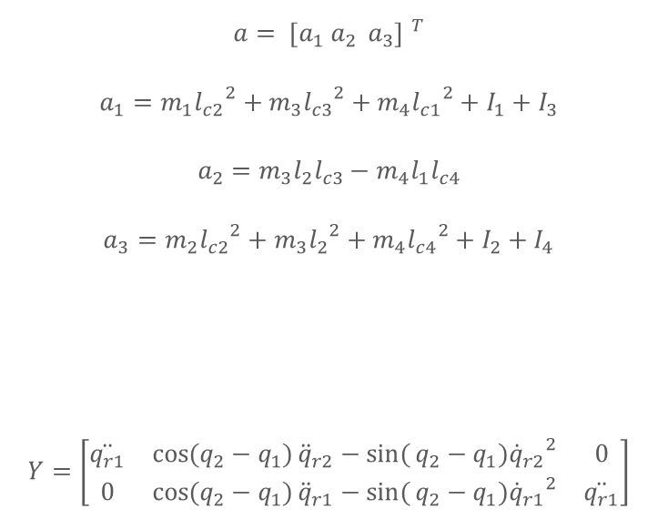

Adaptive Control
$$a= {[a_{1} a_{2 } a_{3}] }^{T}$$
$${a_{1}=m}_{1}{l_{c2}}^{2}+m_{3}{l_{c3}}^{2}+m_{4}{l_{c1}}^{2}+I_{1}+I_{3}$$
$${a_{2}=m}_{3}l_{2}l_{c3}−m_{4}l_{1}l_{c4}$$
$${a_{3}=m}_{2}{l_{c2}}^{2}+m_{3}{l_{2}}^{2}+m_{4}{l_{c4}}^{2}+I_{2}+I_{4}$$
$$Y=\left[\begin{matrix}\ddot{q_{r1}} & \cos{(q_{2}−q_{1})}{\ddot{q}}_{r2}−\sin{(}q_{2}−q_{1}){{\dot{q}}_{r2}}^{2} & 0 \\ 0 & \cos{(q_{2}−q_{1})}{\ddot{q}}_{r1}−\sin{(}q_{2}−q_{1}){{\dot{q}}_{r1}}^{2} & \ddot{q_{r1}}\end{matrix}\right]$$
Torque control
$$τ_{robot}=Y\hat{a}+{J^{T}F}_{human}−K_{d}s$$
Design gains:
$$K_{d}=\left[\begin{matrix}K_{d1} & 0 \\ 0 & K_{d2}\end{matrix}\right]$$
$$Λ_{d}=\left[\begin{matrix}Λ_{1} & 0 \\ 0 & Λ_{2}\end{matrix}\right]$$
$$Γ=\left[\begin{matrix}Γ_{1} & 0 & 0 \\ 0 & Γ_{2} & 0 \\ 0 & 0 & Γ_{3}\end{matrix}\right]$$

Slide 11

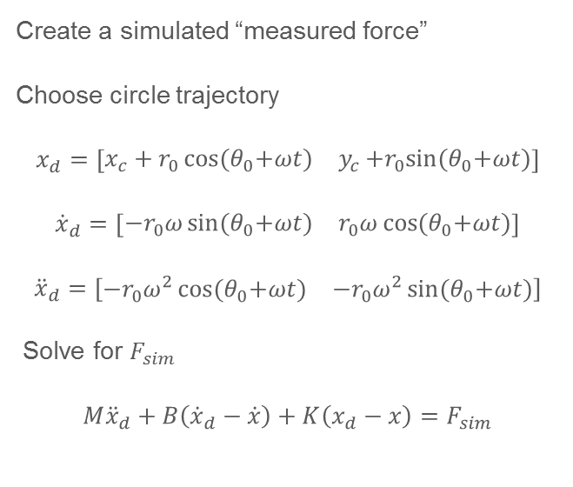
Creating Virtual Trajectory in Simulation
Create a simulated “measured force”
Choose circle trajectory
$$x_{d}=\left[\begin{matrix}{x_{c}+r}_{0}\cos{{(θ}_{0}+ωt)} & y_{c}+r_{0}sin{{(θ}_{0}+ωt)}\end{matrix}\right]$$
$${\dot{x}}_{d}=\left[\begin{matrix}{−r}_{0}ω\sin{{(θ}_{0}+ωt)} & r_{0}ω\cos{{(θ}_{0}+ωt)}\end{matrix}\right]$$
$${\ddot{x}}_{d}=\left[\begin{matrix}{−r}_{0}ω^{2}\cos{{(θ}_{0}+ωt)} & {−r}_{0}ω^{2}\sin{{(θ}_{0}+ωt)}\end{matrix}\right]$$
Solve for $F_{sim}$
$$M{\ddot{x}}_{d}+B\left({\dot{x}}_{d}−\dot{x}\right)+K\left(x_{d}−x\right)=F_{sim}$$
Set
$$F_{sim}=F_{human}$$
From
$$M\ddot{x}+B\left(\dot{x}−{\dot{x}}_{ref}\right)++K\left(x−x_{ref}\right)=F_{human}$$
Solve $x\left(t\right)=x_{v}(t)$

Slide 12
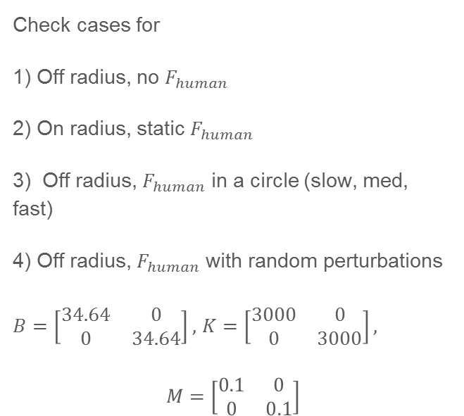
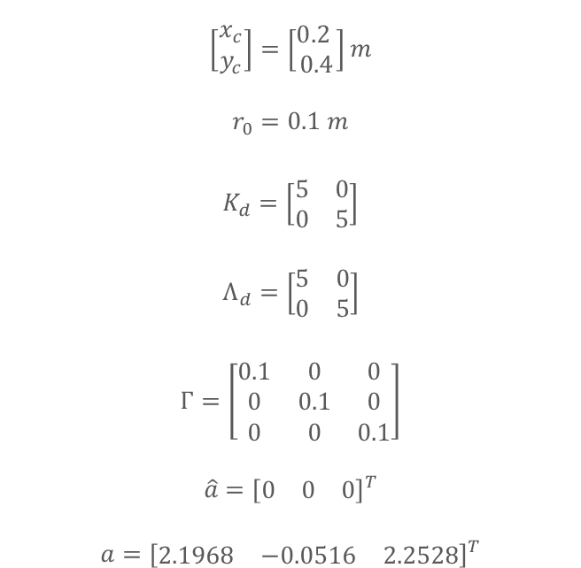
Simulation Parameters
$$\left[\begin{matrix}x_{c} \\ y_{c}\end{matrix}\right]=\left[\begin{matrix}0.2 \\ 0.4\end{matrix}\right]m$$
$$r_{0}=0.1 m$$
$$K_{d}=\left[\begin{matrix}5 & 0 \\ 0 & 5\end{matrix}\right]$$
$$Λ_{d}=\left[\begin{matrix}5 & 0 \\ 0 & 5\end{matrix}\right]$$
$$Γ=\left[\begin{matrix}0.1 & 0 & 0 \\ 0 & 0.1 & 0 \\ 0 & 0 & 0.1\end{matrix}\right]$$
$$\hat{a}={\left[\begin{matrix}0 & 0 & 0\end{matrix}\right]}^{T}$$
$$a={\left[\begin{matrix}2.1968 & −0.0516 & 2.2528\end{matrix}\right]}^{T}$$
Check cases for
1) Off radius, no $F_{human}$
2) On radius, static $F_{human}$
3) Off radius, $F_{human}$ in a circle (slow, med, fast)
4) Off radius, $F_{human}$ with random perturbations
$B=\left[\begin{matrix}34.64 & 0 \\ 0 & 34.64\end{matrix}\right],$ $K=\left[\begin{matrix}3000 & 0 \\ 0 & 3000\end{matrix}\right],$
$$M=\left[\begin{matrix}0.1 & 0 \\ 0 & 0.1\end{matrix}\right]$$

Slide 13
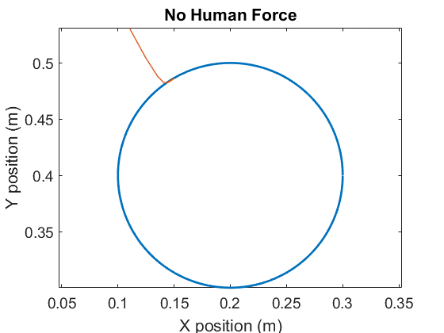
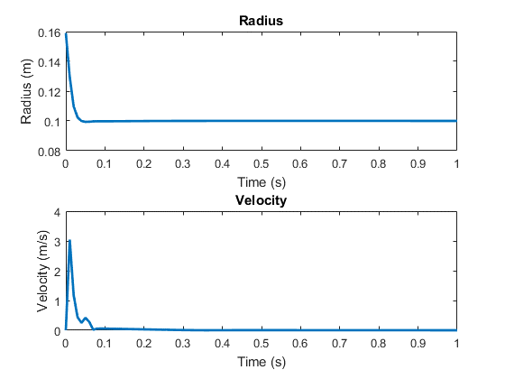
Simulation Results: Off radius, no $F_{human}$

Slide 14
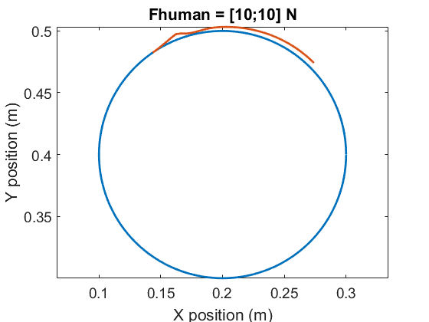
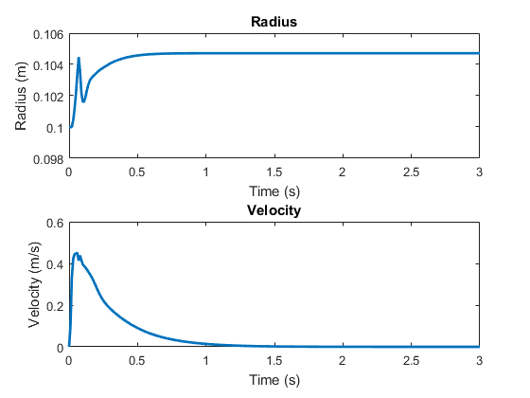
Simulation Results: On radius, static $F_{human}$

Slide 15
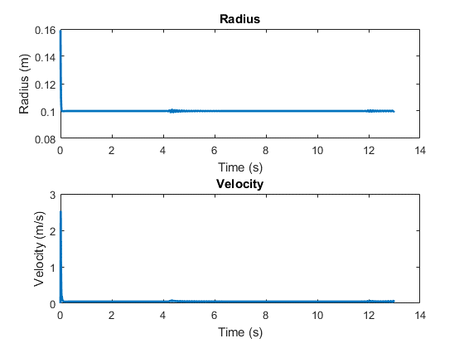
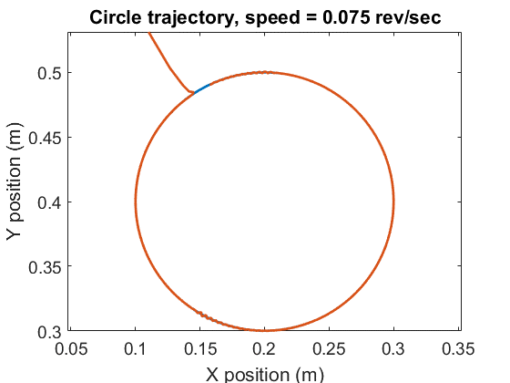
Simulation Results: $F_{human}$ in a circle (slow)

Slide 16
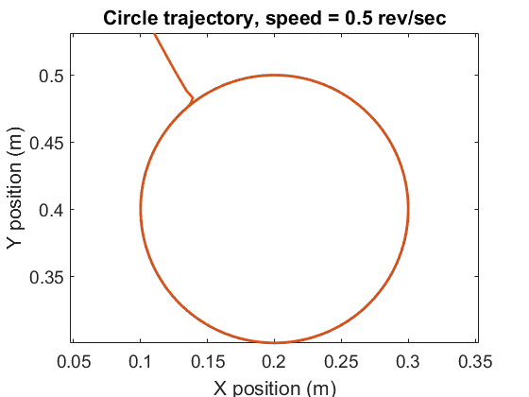
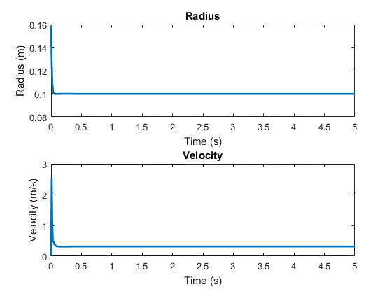
Simulation Results: $F_{human}$ in a circle (medium)

Slide 17
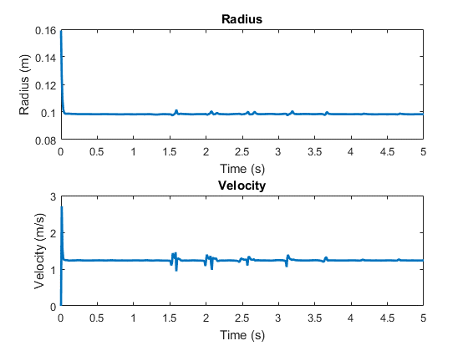
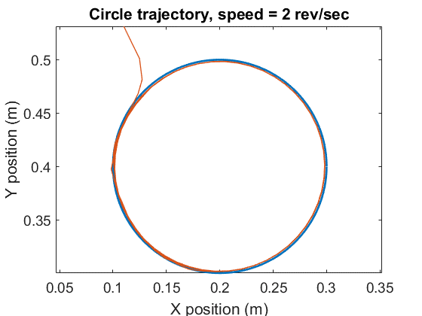
Simulation Results: $F_{human}$ in a circle (fast)

Slide 18
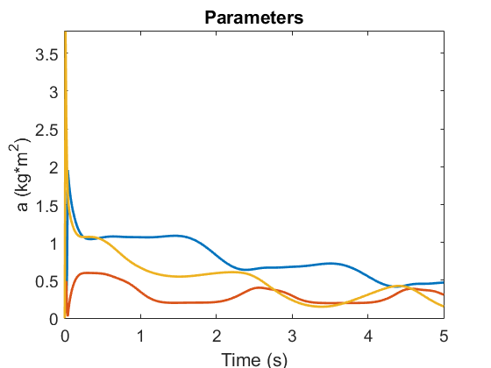
Parameter Update

Slide 19
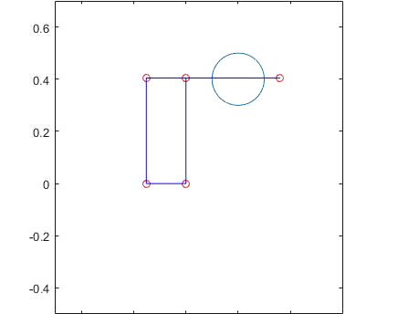
Graphic!

Slide 20
Summary
An adaptive impedance/admittance controller was designed for the InMotion2 robot in order to cancel the device’s non-uniform inertial effects while maintaining the constraint of a virtual crank
Because many of the system’s parameters are unknown or uncertain, an adaptive controller helps to compensate for the errors in the model
The controller design was shown to be globally asymptotically stable.

